Slide 1
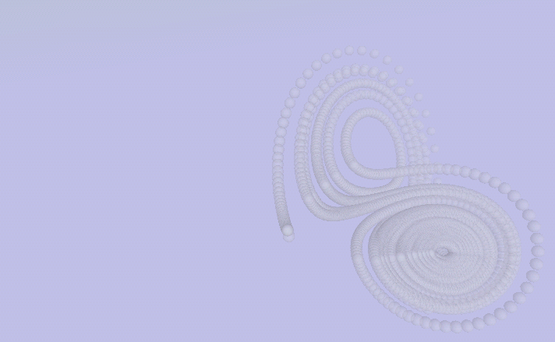
C++ Programming – Classes
Michael Griffiths
Corporate Information and Computing Services
The University of Sheffield
Email m.griffiths@sheffield.ac.uk

Slide 2
Presentation Outline
Object oriented programming
Classes
Data Abstraction

Slide 3
Classes
Data Abstraction
Data encapsulation
Data hiding
Objects

Slide 4
Encapsulation and Abstract Data Types (ADT)
Model defines an abstract view of a problem
Represent model as a collection of abstract data types
Abstract Data type
  Abstract data structure
  Operations defining an interface
Operations of the interface are the only ones allowing access to the types data structure

Slide 5
Primary Characteristics of Object Oriented Programs
Encapsulation
  Mechanism for enforcing data abstraction
Inheritance
  Allow objects to be derived from previously defined objects
Polymorphism
  Different types of objects respond to the same instruction to perform a method that is specific to the particular kind of object

Slide 6
Object Oriented Programming (OOP)
Successful OOP is dependent on good design, this means
  Selecting classes that are relevant that provide the solution for the particular problem under investigation
  Always try and get the right class structure for the application
  In the software lifecycle sometimes necessary to refine classes and introduce new classes

Slide 7
Object Oriented Design
Use OO design techniques such as UML (Unified Modelling Language)
  Use Case Modelling
  Class diagrams
  Sequence diagrams
  Activity diagrams
Aim to minimise the number of iterations in the development cycle

Slide 8
Classes
Class is a data type
Like a structure but includes
  Methods i.e. functions to manipulate the members
An object is an instantiation of a class
Each Class instantitation i.e. each object
  Own copy of data members
  Share methods with objects of same type

Slide 9
Class Declaration
class classname {
public:
classname();
~classname();
vartype m_var;
vartype method(var list);
private:
private members and methods here
}

Slide 10
Member Functions
Constructor function
  Methods to perform when object created
  Initializes object data
Destructor function
  Methods to perform when object destroyed
  Frees any memory used by the object

Slide 11
Data Member Types
public (default)
  Members declared as public can be used by any other objects
private
  Members declared as private can only be read, written by members of this class
protected (see later)
  Data members can be accessed by members of this class and classes that are derived from this class

Slide 12
Simple Class Declaration
//Program8.cpp
//C++ Class example illustrating
//class constructors and destructors
#include <iostream>
#include <cstring> //strcpy and strlen
class WrgComputeNode {
public:
WrgComputeNode(const char *sName ); //Constructor
~WrgComputeNode(); //Destructor
char *GetName(){ return m_sName; }
private:
char *m_sName;
};

Slide 13
Member Functions for WrgComputeNode Class
Function name preceeded by class name and a scope resolution operator
WrgComputeNode::WrgComputeNode(const char *sName )
{
m_sName = new char [strlen(sName)];
strcpy(m_sName, sName);
}
//Delete memory that was allocated for the
//creation of the node name
WrgComputeNode::~WrgComputeNode()
{
delete [] m_sName;
}

Slide 14
Using Classes
Initialising an object
WrgComputeNode Sheffield("Titania");
WrgComputeNode Leeds1("Maxima");
WrgComputeNode York("Pascali");
Accessing Members and Calling Methods
cout << "Sheffield grid node is " << Sheffield.GetName() <<endl;
cout << "Leeds grid node 1 is " << Leeds1.GetName() << endl;
cout << "York grid node is " << York.GetName() << endl;

Slide 15
Class Constructors and the new Operator
In C++ the new function takes the place of malloc().
To specify how the object should be initialized, one declares a constructor function as a member of the class,
  Name of the constructor function is the same as the class name
Methods for declaring a stack class
stack s1(17);
stack *s2 = new stack(2);

Slide 16
Destructors and the delete operator
Just as new is the replacement for malloc(), the replacement for free() is delete.
To get rid of the Stack object we allocated above with new, one can do:
delete s2;
This will deallocate the object, but first it will call the destructor for the Stack class, if there is one.
This destructor is a member function of Stack called ~Stack()

Slide 17
Stack class definition
class stack{
public:
stack(int sz=10);
~stack();
void push(int value);
int pop();
public:
int m_size;
int m_count;
int *m_stack
};

Slide 18
Stack constructor
stack::stack(int sz)
{
m_size=(sz>0?sz:10);
m_stack = new int[m_size];
m_count=0;
}

Slide 19
Stack destructor
stack::~stack()
{
delete [] m_stack;
cout << "Stack deleted." << endl;
}

Slide 20
Example of Using the stack class
int main()
{
stack s1(17);
stack *s2 = new stack(2);
s1.push(5);
s2->push(8);
s2->push(7);
//pop items from the stack
cout << "Popping stack s1 gives " << s1.pop() << endl;
cout << "Popping stack s2 gives " << s2->pop() << endl;
cout << "Popping stack s2 gives " << s2->pop() << endl;
cout << "deleting stack s2: ";
delete s2;
return 0;
}

Slide 21
Inheritance
Inheritance is a mechanism by which base classes can inherit data and methods from a base class
The new class is called a derived class
An object of a derived class may be treated as an object of the base class

Slide 22
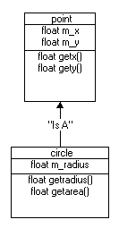
A Shape Defined by A Object Defining its Position

Slide 23
Base Class Definition
class point {
public:
point(float x=0, float y=0); //Default constructor
void setpoint(float x, float y);
float getx() const {return m_x;}
float gety() const {return m_y;}
protected: //accessible only by derived classes
float m_x;
float m_y;
};

Slide 24


Derived Class Definition
class circle : public point { //circle inherits from point
public:
circle(float r, float x, float y); //default constructor
void setradius(float r);
float getradius() const;
float getarea() const;
protected:
float m_r;
};

Slide 25
Creating Instances
point *pointPtr;
point p(2.1, 3.2);
circle *circlePtr;
circle c(3.2, 1.7, 3.9);
pointPtr = (point *) &c;
circlePtr = &c;

Slide 26
Calling Object Methods and Members
cout << "Point p: x=" << p.getx() << " y=" << p.gety() << endl;
cout << "Circle c: radius=" << c.getradius() <<" x=" << c.getx()
<< " y=" << c.gety() << " area=" << c.getarea() << endl << endl;

Slide 27
Treating a circle object as a point object
cout << "Using point pointer to access circle base class information"
<< endl;
cout << "Circle c: x=" << pointPtr->getx()
<< " y=" << pointPtr->gety() << endl;

Slide 28
Treating a circle object as a circle base class
cout << "Using circle pointer to access circle base class information"
<< endl;
cout << "Circle c: x=" << circlePtr->getx()
<< " y=" << circlePtr->gety() << endl;

Slide 29
Virtual Functions and Polymorphism
Through virtual functions and polymorphism it is easier to extend systems and to reuse objects
programs take on a simplified appearance with less branching logic
Easier to maintain applications

Slide 30
The Shapes Example
treat all shapes as a generic instances of the base class shape
When a shape is drawn we then simply call the Draw method of the shape base class
program determines dynamically at execution time which Draw method should be used
Extend our circle class by introducing different shapes and a base class called shape

Slide 31
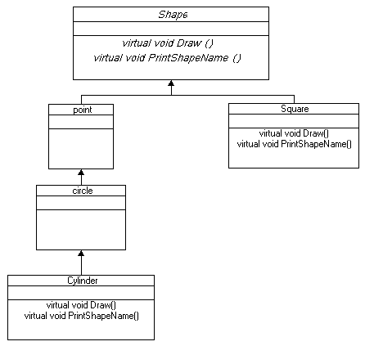
Polymorphism – Abstract Classes

Slide 32
Abstract shape class
class shape {
public:
virtual float area() const {return 0.0;}
virtual float volume() const {return 0.0;}
virtual void printShapeName()=0; //pure virtual
};

Slide 33
A concrete class
class square : public shape{
public:
square(float x=0); //Default constructor
void setside(float x);
float getside() const {return m_side;}
virtual void printShapeName(){cout << "Square: ";}
virtual float area() const {return(m_side*m_side);}
protected: //accessible only by derived classes
float m_side;
};

Slide 34
Code fragment illustrating polymorphism
void main()
{
int i;
shape *shapearray[3];
point p(2.1, 3.2);
circle c(3.2, 1.7, 3.9);
square s(4.5);
shapearray [0] = (shape *)&p;
shapearray [1] = (shape *)&c;
shapearray [2] = (shape *)&s;
for(i=0; i<3; i++)
{
cout << "Area of ";
shapearray[i]->printShapeName();
cout << shapearray[i]->area() << endl;
}
}

Slide 35
Abstract Classes and Virtual Functions
abstract class called shape which is inherited by two new shapes cylinder and square
since shape is abstract and it does not express a concrete realisation of a shape we cannot define the Draw method
  Draw function of the shape base class is said to be vitual

Slide 36
Polymorphic behaviour through abstraction
Virtual functions in an abstract base class.
  Desired behaviour obtained dyamically by selecting the correct methods for concrete realisations of a class
Method is defined in each of the derived classes.
In this sense a collection of objects referenced using the shape class exhibit polymorphic behaviour
  behaviour dependent on the specific methods defined for the derived classes.

Slide 37
Recommendation
Do not mix C and C++ Programming Styles
  External c libraries can still be called
For C++ programs use the ANSI C++ header nad not the ANSI C headers standard libraries
Keep things simple
  Build Create new classes when necessary
  Take care when using inheritance
Avoid re-inveting the wheel, use SDK’s
  See the code repository references below

Slide 38
Conclusion
Advantages
  Powerful development language for HPC applications
  Portable
  Reusable
  Requires careful design
  Wide range of libraries enabling high performance and rapid development.
Disadvantage
  Very easy to develop sloppy and inefficient code!!!!!!!!

Slide 39
References
http://www.cplusplus.com
Standard template libraries
  http://www.sgi.com/tech/stl/table_of_contents.html
Bjarn Stroustrups homepage
  http://www.research.att.com/~bs/homepage.html
Documentation for Sun Compilers
  http://developers.sun.com/prodtech/cc/compilers_index.html

Slide 40
Code Respositories
http://sourceforge.net/
http://www.netlib.org/
http://freshmeat.net/
http://archive.devx.com/sourcebank/
http://www.boost.org/
http://www.oonumerics.org/oon/

